Slide 1


Eric Qiao, Nicolas Newberry, Ferdaous Hellara, Cyprian Bekha

Slide 2
Situation Overview
Purchase TargetCo
TEV
w/o fees
EBITDA
Multiple w/o fees
IRR
2024 Transaction Structure
Revenue | 589
Entry EBITDA | 59
Enterprise Value w/o fees | 480
Debt | 308
Equity | 196
Fees | 25
TEV multiple with fees | 8.6x
Entry
$482M
$59M
8.2x
Base 5Y Exit Statistics
$784M
$96M
8.2x
23.10%
Downside 5Y Exit Statistics
2029 Transaction Structure | Base case | Downside case
Organic Revenue | 797 | 599
EBITDA | 96 | 59
Organic | 95 | 59
Add-on | 1 | 0
TEV multiple | 8.2x | 8.0x
Enterprise Value | 784M | 469M
MOIC | 2.8x | 1.2x
IRR | 23.10% | 3.51%
$469M
$59M
8.0x
3.51%
Merits
Risks
Premiumization and humanization of pet food
Strong moat created from barriers to entry and customer switching costs
E-commerce boosts customer exposure
Product recall shocks TargetCo’s sales
Limited M&A opportunities to expand into dry pet food
Petflation cools
Performance linked to large customers

Slide 3
Company Overview
TargetCo lies in the pet food production industry for wet, dry, and treats, servicing contracted brands and retailers.
Founded in 1972, TargetCo has become one of the largest players in the pet food production for private labels, particularly dog and cat food. They currently have 4 large US production plants spread across the US – 3 of them dedicated to wet food, with the final greenfield built for dry food more recently. These facilities are highly specialized and capital intensive to rollout millions of pounds of food annually for their customer base.
Contract Manufacturing
Private label
Sales Breakdown by Customer
Established brands, such as Blue Buffalo, outsource production to established manufacturers – offering financial savings, time efficiency, and increased capacity. TargetCo handles manufacturing, while brands control unique formulas, procurement, and packaging to push out greater sales.
The company manufactures products for retailers, under a white-label approach – formulating, designing, packaging, purchasing, and manufacturing for retailers. TargetCo reformulates more established brands’ most popular pet foods, given the FDA’s requirement for high ingredient visibility in labeling.
TargetCo has 3 main product segments - wet is the most established, while treats and dry food were only recently entered.
Wet Food
Dry Food
Treats
Canned Pâté
Kibble Variants
Rewards / Indulgence
Sources: GlobalPETS

Slide 4
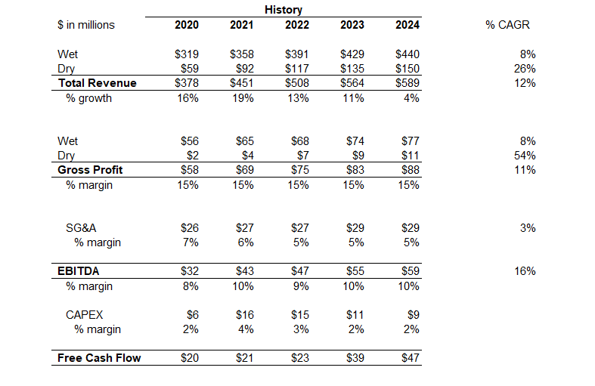
TargetCo’s Historical Financials
Major Investments in TargetCo’s History
2002
Purchased the wet food segment from Doane Pet Care.
2004
P&G’s facility was acquired to increase manufacturing capacity.
2018
Private label dry pet food market expansion with Walmart.
2022
Private label pet treats market expansion.
Notes:
2007: Melamine Pet Food Recall A massive recall rocked the pet food industry when melamine-tainted wheat gluten from China, used in both branded and private label wet and dry pet foods, led to thousands of pet illnesses and deaths. Over 150 brands, including private label products from Menu Foods (a major contract manufacturer), were affected. This event eroded trust in pet food safety, prompting stricter regulations and boosting demand for transparency, which private labels later capitalized on with “value plus quality” messaging.
2008-2009: Great Recession Boosts Private Label Adoption The global financial crisis shifted consumer spending toward cost-effective options. Private label pet foods, especially dry kibble (e.g., Kroger’s Pet Pride), saw increased sales as pet owners sought affordable alternatives to premium brands. Wet pet food private labels also gained traction, with retailers like Walmart expanding offerings. This period marked a turning point, with private label usage rates beginning to climb (e.g., dry dog food usage rose from 9% in 2017, suggesting earlier growth from 2009).
2011: Simmons Pet Food Expands Private Label Capacity Simmons Pet Food, a leading North American private label wet pet food manufacturer, opened a new facility in Emporia, Kansas, enhancing its ability to produce canned and pouched products for retailers. This expansion reflected growing retailer investment in private label wet pet food, capitalizing on demand for convenient, value-driven options.
2013: PetSmart Acquires Authority Brand Development PetSmart bolstered its private label portfolio, including Authority wet and dry pet foods, by investing in in-house development. This move solidified private labels as a competitive force against national brands, with Authority becoming a flagship offering in over 1,000 stores, blending quality and affordability.
2015: J.M. Smucker Sells Private Label Business J.M. Smucker sold its private label dry pet food business to Diamond Pet Foods for $33 million, signaling a strategic shift among large manufacturers. Diamond, a key private label producer, used this acquisition to expand its dry pet food output for retailers, reinforcing the segment’s growth amid rising pet ownership.
2017: Chewy’s IPO Highlights Private Label Potential PetSmart’s Chewy went public with a $14.3 billion valuation, spotlighting its private label brands like American Journey (dry and wet pet food). Though Chewy operated separately, this event underscored how private labels could compete with premium brands online, influencing retailers to enhance their own offerings.
2020: COVID-19 Pet Boom Accelerates Private Label Sales The pandemic drove a surge in pet adoptions (66% of U.S. households owned pets by 2020-2021, per APPA), boosting demand for affordable pet food. Private label dry dog food usage hit 10.1% by 2022 (up from 9% in 2017, per Packaged Facts), and wet cat food usage rose to 59% from 49% in 2006-2007. Retailers like Aldi and Lidl expanded private label lines (e.g., Heart to Tail), leveraging supply chain control.
2021: Alphia Formed Through Merger The merger of C.J. Foods and American Nutrition created Alphia, a powerhouse in private label pet food production. With facilities producing both wet and dry products, Alphia became a go-to partner for retailers like Costco (Kirkland Signature), amplifying private label scale and quality in North America.
2022: Inflation Drives Private Label Surge Pet food inflation soared (e.g., consumer price index flipped from -1.1% in January 2025 to +0.4% in February, per later trends), pushing consumers toward private labels. Sales of private label dry and wet pet foods grew as 73% of pet owners sought lower-priced options (Packaged Facts, 2024 survey), with Europe at 25% private label share and the U.S. at 20% (Mintel, 2023).
2023: PAI Partners Acquires Alphia PAI Partners bought Alphia for approximately $1 billion, reflecting private equity’s bullish outlook on private label pet food. This deal, one of the largest in the segment, highlighted the profitability of wet and dry private label production, driven by demand for value and retailer branding.
2024: Kemin Opens Wet Pet Food Pilot Plant Kemin Nutrisurance launched its first wet pet food pilot plant in Kansas, aimed at innovating private label formulations. This facility supported retailers in developing premium-like wet pet foods, aligning with trends toward humanization and quality, even in value segments.

Slide 5
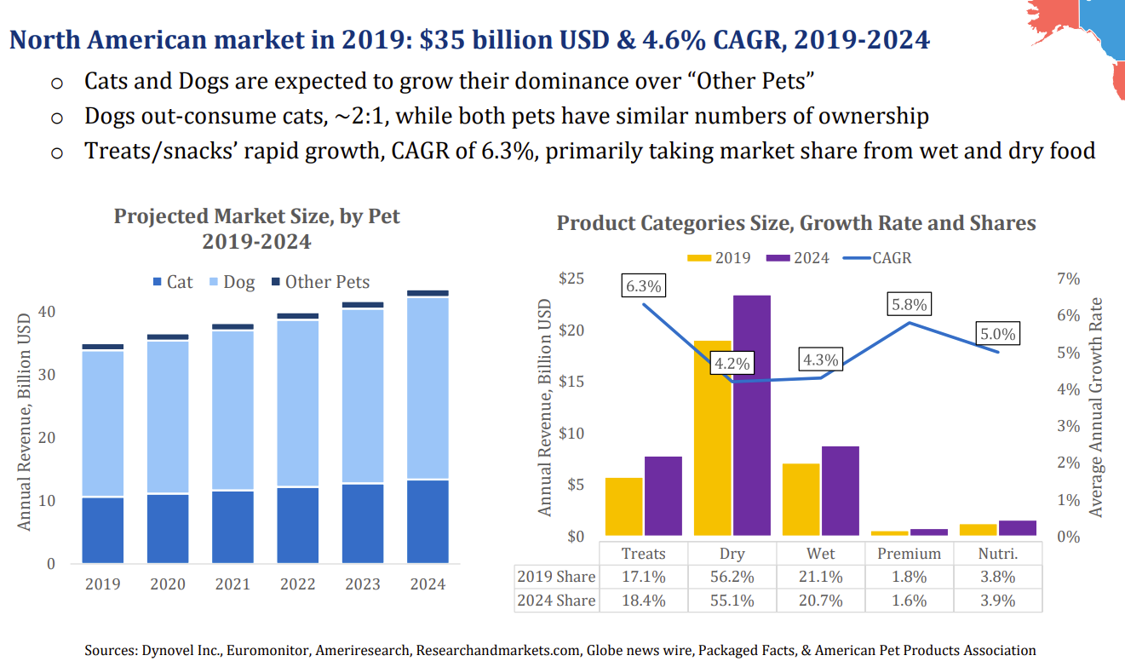
Market Overview
The pet food sector is highly concentrated as the top 10 manufacturers held 75% market share in 2023. Private label specifically only captured ~15% of overall revenue in 2023, serving as a rising alternative to national brands.
Dog and cat ownership has monopolized the pet market, comprising ~80% of pets owned by US households. Within all pet foods, lies product categories that TargetCo participates in, with the dry market dominating other alternatives.
2019 Share | 17.1% | 56.2% | 21.1% | 1.8% | 3.8%
2024 Share | 18.4% | 55.1% | 20.7% | 1.6% | 3.9%
Sources: PangoVet, Euromonitor, Nestle, HSBC, ITC, American Pet Products Association, Packaged Facts

Slide 6
Overview of the Wet Pet Food Market
Business Model
Market Trends
TargetCo purchased its wet food operations in 2002, operating 3 large 100,000+ square foot NA facilities.
Divided into Pâté, Minced & Shredded, Gravies & Chunks, Morsels & Chewed
High nutrition, palatability, and protein levels, given wet’s concentrated moisture. However, it expires fast and produces odor.
Wet pet food has experienced rising purchases by both dog and cat owning households, valued at a combined $33B market size growing at approximately 5% CAGR between 2023 – 2029.
Wet dog and cat food usage has considerably risen from 34% to 38% and 49% to 59% respectively between 2006 – 2021.
Rising need to source more nutritious, sustainable ingredients
“Petflation” spread throughout the pet product industry, as high input cost pressures were passed down throughout the supply chain from manufacturers to retailers to pet owners
TargetCo is the leading private label wet pet food manufacturer, for 25% of its sales mix, producing steady gross profit in excess of $1.5 per unit over the past 8 years. However, volume growth, for this sector specifically, has subsided in recent years, as TargetCo matures over its 20+ year history.
Sources: Fromm Family Pet Food, Houndsy, PetFood Industry, Scales Global Nutrition, Statista, Nestle Purina

Slide 7
Overview of the Dry Pet Food Market
Business Model
Market Trends
TargetCo launched its dry pet food manufacturing line in 2018, with Walmart as its pioneer customer to help build TargetCo’s Arkansas 90,000 square foot facility.
Primarily consisting of kibble for dogs, dry is sold cheaper with a longer shelf life. However, it often lacks palatability and protein levels.
Dry pet food has seen strong utilization and purchases by both dog and cat owning households, valued at a combined $63B market size growing at approximately 5.7% CAGR between 2023 – 2029.
Dry dog and cat food usage has risen from 91.6% to 93.8% and 89.3% to 93% respectively between 2006 – 2021.
Rising need to source more nutritious, sustainable ingredients.
E-commerce and direct-to-consumer (DTC) are pushing new growth in the industry, as personalization of pet products and food becomes more popularized.
Unlike the wet pet space, TargetCo is a new private label manufacturer entrant for 75% sales mix, with a gross profit per unit of $0.1 compared to the more lucrative wet food side. However, volume has seen substantial scale with a CAGR of 30% over the past 5 years.
Sources: Fromm Family Pet Food, Houndsy, PetFood Industry, Scales Global Nutrition, Statista, Nestle Purina

Slide 8
Channel Mix Overview
TargetCo supplies for 4 key types of retail customers. These distribution channels then sell to the end customer, pet owners, through brick-and-mortar stores or E-Commerce.
Mass Merchandisers
Pet Specialty Stores
Grocery
Contracted Brands
Comprised of discount stores and superstores, the largest players are Walmart and TargetCo due to shopping convenience and bulk purchases.
National and regional pet stores that specialize in animal food, accessories, treats. The largest pet superstores include PetSmart and PetCo.
Local and established chains that often sell a wide variety of other CPGs alongside some pet food offerings, such as Kroger, Alberstons, and Meijer.
These brands source, formulate, and package, as TargetCo’s exclusively handles the manufacturing. TargetCo’s key customer is Blue Buffalo.
TargetCo
Overall Market

Slide 9
Merits & Risks

Slide 10
Merits Summary
1. Strong Financial Performance: TargetCo has displayed promising free cash flow growth, growing from $20M in 2020 to $47M in 2024. TargetCo has proved to be a recession resistant business with revenues growing 16% in 2020 and 19% in 2021 in the midst of the Covid-19 pandemic. Additionally, TargetCo has strong pricing power maintaining very stable margins of ~15% throughout this period.
2. High Barriers to Entry: The pet food industry is characterized by high entry barriers, including strict regulatory oversight (FDA audits & HAACP compliance standards), a complex and costly supply chain, and substantial capital expenditure, factory construction alone requires an investment of tens of millions. As a result, market access remains highly restricted.
3. Customer Switching Costs: In recent history, pet food retailers have suffered through a variety of devastating recalls that have caused serious damage to their business including 2007 Menu Food’s Recall, Mid America 2023 Pet Food Recall, Gravy Train Recall (2018), and Mars Petcare Pedigree 2024 Recall. The risk of product recalls and their potential impact on brand reputation and sales makes it difficult for customers to switch suppliers. Retailers are willing to pay extra on price to avoid the potential legal liabilities, supply chain issues, and brand damage that come with a devastating recall.
4. E-commerce Shift: Consumers are increasingly shifting spending to online platforms, expanding the total addressable market for pet food. Chewy’s rapid rise illustrates this trend, after acquired by PetSmart for $3.35B in 2017, it has since grown to an enterprise value of ~$14.8B, reflecting a ~20% 8-year CAGR. Online players like Chewy benefit from strong recurring revenue streams through subscriptions that simplify food delivery for pet owners and makes pet food more accessible. The online pet food market is projected to grow at a 7.8% CAGR from 2025 to 2030. Existing relationships with major e-commerce retailers such as Amazon and Chewy position TargetCo for further growth.
5. Premiumization & Humanization – Pets Become Family: Over 70% of pet owners value their pets’ well-being as much as that of their family, fueling demand for healthier, premium products. This humanization trend, combined with rising human and pet populations, directly benefits TargetCo, whose focus on nutrient-dense wet dog food aligns with shifting consumer preferences for higher-quality nutrition
6. Inflation Drives Revenue Growth: In a resilient Industry, despite global economic uncertainty, inflationary pressures have been successfully passed through to end consumers without impacting demand. Inflationary pressure has allowed Target, and its competitors, to charge more. It has been a strong growth driver for the business. Increasing inflation is expected in the future with the onset of Trump’s tariffs, including a 25% tariff on aluminum.
7. Private Label Industry is Gaining Momentum: With a weaker consumer and increased recessionary risk, consumers are shifting their spending preferences to private label over traditional brands. TargetCos positioning in the private label market, servicing ~70% of the wet food market and ~25% of the dry food market makes it ideally positioned to experience growth in a recessionary environment where consumers choose to trade down to cheaper private label products.
Notes:
https://investor.chewy.com/news-and-events/news/news-details/2017/PetSmart-Completes-Acquisition-of-Chewy/default.aspx
https://www.whitecase.com/insight-alert/president-trump-expands-steel-and-aluminum-tariffs-all-countries-effective-march-12

Slide 11
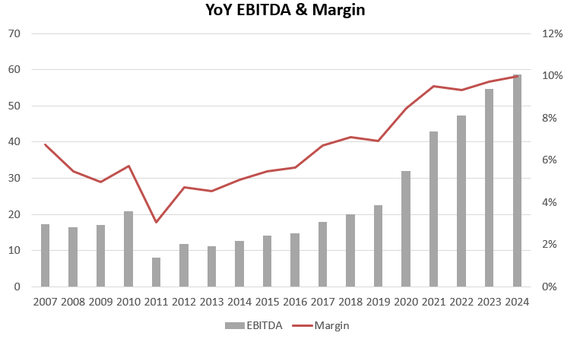
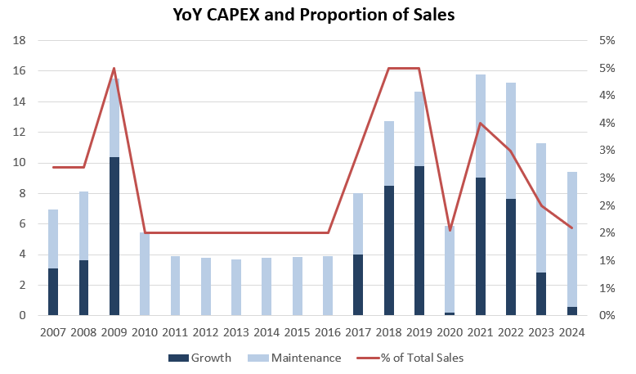
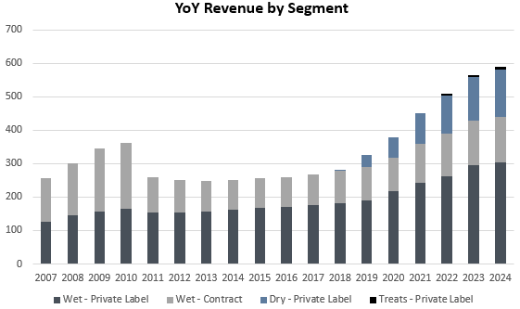
Sustained Strong Financial Performance
High Cash Generation creates flexibility for strategic investments and debt paydown.
TargetCo’s FCF has seen significant growth in recent years, in part because of PetFlation, with the value increasing from $20M to $47M between 2020 – 2024. 2023 saw a 67% growth.
EBITDA
CAPEX
Diverse Revenue Growth
TargetCo continues to demonstrate consistent EBITDA growth, increasing from $32M in 2020 to $59M in 2024.
Margin expanded from 8.5% to 10% over the same period, reflecting TargetCo’s resiliency during recessions.
TargetCo has historically maintained low, steady CAPEX, as the firm emerged as an efficient, market leader.
Strategic investments were made in 2018 and 2022 to enter the dry and treat markets, which explains the temporary CAPEX increase.
TargetCo revenue grew from $378M to 589M, driven by:
Wet Food: Stable 9% and 4% CAGR in private label and contract
Dry Food: 24% CAGR since 2018 launch, now $141M
Treats Segment: Rapid scaling from $0 to $9.1M
Notes:
Insulated by blah blah

Slide 12
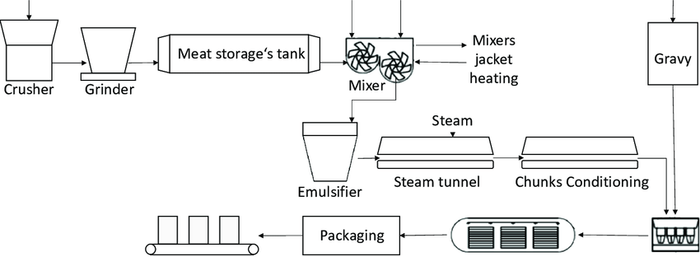
Structural Barriers Limit New Entrants
The pet food manufacturing process is highly complex, requiring specialized equipment, compliant infrastructure, digital monitoring systems, quality controls, and technical expertise – creating substantial barriers to enter and scale.
High Capital Requirements
Strict Regulations
New wet pet food facilities are expensive to build due to sterilization, canning, and strict safety controls…
Competitor investments confirm high costs:
Simmons Pet Food invested $115M in wet & dry food production (2022).
Mars Petcare invested $82M to expand its pet treat facility in Kansas City.
Nestlé Purina committed $99M for two new production lines in Silao, Mexico (2022)
Diamond Pet Foods built a $259M facility in Indiana for dry & wet food manufacturing (2022).
The pet food industry is subject to strict FDA, USDA, and EPA regulations, requiring manufacturers to implement…
HAACP-based controls,
Daily pathogen tests [e.g. for Salmonella and aflatoxins], and
Regular facility audits.
Pet Food Safety Criteria
Allergen Management
Supplier Audits
Traceability & Recall Systems
Hazard Analysis & Critical Control Points
Packaging & Labeling Control
Good Manufacturing Practices [GMPs]
Operational Complexity
Pet food production is a complex process involving several key challenges:
Ingredient sourcing must ensure high-quality and ethically produced raw materials to provide nutrition.
Packaging must protect the product’s freshness and meet regulatory labeling requirements.
Nutritional requirements must be met, tailoring formulas to pets' specific needs based on their species, life stage, and health conditions.
Wet Pet Food Process Flow Diagram
Sources: Essential ingredients to Enhance the Safety of Pet Food Manufacturing, Arundhathy Shabu, Oct 10, 2023
Pet Food Recalled for Potentially Fatal Levels of Aflatoxin, Dr. Scott Fritz
Notes:
Growing PMA acceptance attracts new customers
PMA approvals by the FAA have grown in recent years, with 2011 - 2015 versus 2006 - 2010 volume increasing by approximately 39%

Slide 13
Customer Switching Costs Reinforce Competitive Moat
Most private label customers are large, multinational consumer-facing brands. When a recall occurs, the retailer will face the most reputational damage, dissuading switches to unproven manufacturers.
Past Pet-Related Product Recalls
Menu Food’s Recall (2007):
Menu Foods, a major contract manufacturer for brands, including private label retailers like Wal-Mart, initiated a recall of over 60 million containers of wet pet food. Due to a melamine contamination, the recall resulted in kidney failure and deaths for 1,000+ pets. >50 dog, and >40 cat food brands.
…these factors play into TargetCo’s Consumer Value Proposition
Mid America Pet Food Recall (2023):
Occurred in September/November of 2023. Expanded to all products with best-by dates before 10/31/2024 due to salmonella. Salmonella contamination spread beyond just pet food, affected ~100,000+ units, linked to seven human cases (six in children). Impacted multiple brands (Victor, Wayne Feeds, Member’s Mark), dry dog/cat food, sold at Walmart, Sam’s Club, Amazon.
Industry leading services with major retailers puts TargetCo in an ideal position for retaining current customer base and attracting new business.
Associated Damages
Reputational Risk: Retailers have invested millions into their private label brands such as for advertising. For instance, TargetCo recently valued their private label brand, Good & Gather at ~$2B. This is a place where retailers are looking to expand aggressively, requiring a solid supply base to do so.
Legal Liability Costs: Estimated cost of $30M in direct lawsuits from Menu Food’s 2007 Recall, which targeted pet food manufacturers and retailers.
Damaged Brand Value: Retailers invest millions in marketing brands to attract customers. Many pet owners love their pets and would likely ditch a retailer with past recall issues.
Supply Chain Disruptions & Indirect Costs: Other long-term damages include supply chain disruptions, lost revenue, and replacement/refund costs.
Switching a supplier is far too risky for customers given the high costs involved in product recalls…
… combined with a concentrated market makes it difficult for retailers to find alternative suppliers.
Sources: avma.org, Investopedia, EBSCO, foodbusinessnews
Notes:
https://www.investopedia.com/financial-edge/0512/the-5-largest-food-recalls-in-history.aspx
https://www.allaboutfeed.net/animal-feed/feed-additives/recall-of-60-million-pet-food-cans/
https://www.ebsco.com/research-starters/politics-and-government/manufacturer-recalls-pet-food-killed-thousands-american#:~:text=In%20March%202007%2C%20Menu%20Foods,for%20both%20pets%20and%20humans.
PMA approvals by the FAA have grown in recent years, with 2011 - 2015 versus 2006 - 2010 volume increasing by approximately 39%

Slide 14
Pet Food Industry Embraces E-Commerce Growth
TargetCo can capitalize on the surge in e-commerce, as customers can more conveniently and easily purchase product.
The global pet care e-commerce market size was estimated at 94.89 billion in 2024 and is projected to grow at a CAGR of 7.8% from 2025 to 2030.
Across other pet products as well, e-commerce has created greater visibility for the breadth of products, accelerating during COVID.
Chewy as a case study represents the growth of e-commerce and a tailwind for increased production demand.
One of the largest dog and pet e-commerce companies, in FY25, Chewy recorded revenues of ~$11.9B. Growing at a 5-year CAGR of 19.6%.
This shows the traction that e-commerce is gaining in the industry, Chewy is already a customer, having represented ~3% of TargetCo’s current volume.
TargetCo’s other customers are well positioned to benefit from rise in e-commerce as well…
Walmart: Walmart’s online sales now account for over 6.4% of total e-commerce sales, surpassing Apple and eBay as the second largest e-commerce retailer in the United States.
PetSmart: PetSmart is actively expanding e-commerce operations, with ~14.5M website visitors during January 2025.
Blue Buffalo: Blue Buffalo already sells across a variety of brand name retailers with strong e-commerce capabilities. Retailers carrying their product include Petco, Walmart, TargetCo, and PetSmart, as a means of diversification and exposure in online sales.
Sources: Statista, SimilarWeb, Factset, Grandview Research, Jefferies, Euromonitor Passport, Harris Williams, Chewy’s Earnings
Notes:
https://www-statista-com.proxy.lib.umich.edu/statistics/274255/market-share-of-the-leading-retailers-in-us-e-commerce/
https://www.digitalcommerce360.com/article/walmart-online-sales/
https://bluebuffalo.com/store-locator/
https://assets.ctfassets.net/pn8wbiqtnzw9/2ye3HlWNQ3zecZcaHmqgRJ/91620c1366dd6985ed6fb59e4704fc50/US___Canada_Report_-_Pet_Market_Overview.pdf
https://pro.similarweb.com/#/digitalsuite/websiteanalysis/overview/website-performance/*/999/3m?webSource=Total&key=petsmart.com

Slide 15
Humanization and Premiumization Fuel Pet Owner Spending
Shifting consumer attitudes towards higher quality alongside growing ownership to flow into pet food supply chain/
Forecasted Spend for Premium Pet Food
Key Drivers for the Pet Food Industry
A growing movement to prioritize science-based, healthier products, as 43% of owners claim they pay a premium price to improve their pet’s nutrition.
1
Humanization
The rise of “pet parents” have coincided with a growing sentiment that pets are akin to children. Over 90% of owners view their pets as a cherished family member or an important companion. 71% of these same owners would prioritize or hold equal weight for pet spend relative to themselves or any other household member.
2
Generational Preferences
Gen Z and Millennial customers push for better nutrition for their pets. Reflected in 2018’s monthly US pet spend, 18 – 24 year olds spend nearly 60% more than the 35 – 44 and two times 65+ categories. This is only amplified with the 20% increase by 2030 in Gen Z and Millennials’ proportion of the workforce.
% of Total Cat Food Market
25% | 25-30% | 25-30% | 30%
3
Continued Volume
Although US pet ownership penetration has slowed post-COVID, reaching a high of 70% in 2023 to falling to 66% in 2023, the overall volume of households with pets is expected to continue increasing at pre-COVID rates. This steady trend reflects rising pet adoption, declining birth rates, and disposable income catalysts.
Sources: ARPA National Pet Owners Survey, Allianz Global Investors, Harris Williams, OC&C Strategy Consultants, American Veterinary Medical Association, OppLoans 2018 Pet Ownership Survey
Notes:
The large number of parked operating Increased will create upward pressure on airframes and engine maintenance that Target

Slide 16
Inflation Enables Pricing Power for TargetCo
Amidst serious inflation occurring in the world and pet food industry particularly, national brands have shown resiliency through their pricing power.
On the backdrop of higher inflation, during FY23, Nestle’s Purina brand has increased its prices substantially translating to strong revenue growth.
Purina PetCare organic grew 13.1%, representing the highest growth out of all other Nestlé categories over the period, with pricing up 10.4% in a single year.
“Growth was driven by pricing as we continued to navigate historic inflation levels” from Nestlé CEO during FY23 results
“PetCare posted continued strong double-digit growth despite capacity constraints” from Nestlé CFO during FY23 results
Russia’s 2022 invasion of Ukraine, a country known as the “breadbasket of the world,” disrupted supply chains, driving up food inflation and significantly impacting pet food prices. Combined with broader inflation, CPI rose from ~155 in 2021 to ~190 in 2023. Ukraine’s recovery is expected to take decades and cost over $520B.
“Mars Inc. reported good operating results for fiscal 2022, despite double-digit inflationary pressures ” from S&P Global
“Corporations are starting to see slowing volumes, but when you factor in price rises of 10% or more, the overall impact on revenue is limited. The positive tailwinds of cost inflation are helping earnings” from J.P. Morgan
Catalyst for TargetCo
As a direct competitor with Nestlé and Mars in the broader pet food industry, TargetCo has been able to follow along the price hikes of industry leaders. Furthermore, Nestlé performance during the inflationary environment demonstrates pet food demand’s inelasticity, unlike other CPGs or discretionary spend items.
Source: FRED, petfoodprocessing.net, Cobank, Nesle, J.P. Morgan, Reuters, S&P Global, Mars Petcare
Notes:
https://www.petfoodprocessing.net/articles/17534-purina-grows-through-cost-inflation-capacity-constraints
https://www.dailydot.com/news/blue-buffalo-dog-food-inflation/
https://sso.cobank.com/documents/7714906/75983926/KED-PrivateLabel-Sep24.pdf/54187ea0-7d98-af04-d184-d39544a27725?t=1726250165488#:~:text=Amid%20elevated%20demand%20for%20food,in%20the%20past%20several%20months.
https://www.jpmorgan.com/insights/global-research/economy/inflation-cost-of-living#:~:text=Due%20to%20higher%20inflation%2C%20consumers,as%20a%20consequence%20of%20inflation.

Slide 17
Private Label Positioned for Continued Growth
The private label sector has outpaced the growth of brands recently, as it becomes more recognized. COVID particularly served as an inflection point for private label, as some customers considered cheaper substitutes.
Brand Trade-Down
Switched to Own-Label within Same Food Type
Switched to Cheaper Brand within Same Food Type
Food Mix Shift
Switched to Cheaper Food Type
Changed Feed Mix, Increasing % of Cheaper Food
Although loyalty remained strong for many national brands because many owners are unwilling to cut pet spend, especially related to health, private label’s emergence as an upstart with ~10% share doesn’t come as a surprise…
For the pet food sector, it has been a cheaper alternative for retailers and pet superstores. The reduced marketing and advertising costs relative to brand names, has generated 50% profit margin on own-brand pet foods for retailers.
Despite COVID supposedly providing a temporary stimulus, consumer perceptions have/are shifted, with private label overcoming the lower quality, low-price stigma compared to legacy brands. Secondly, private label is beginning to bridge the gap in offerings as well, with expansions into the mid-price and premium ranges.
2021 Private Labels unit sales rose +11%, while national brand flattened.
63% of Private Brand Shoppers view them as good value.
TargetCo is well-positioned to take advantage of 1) economic conditions prompting some customers to pursue lower cost, equivalent quality alternatives, 2) higher prioritization for shelf space by retail channels, and 3) overall pet food tailwinds as TargetCo can quickly reformulate the success of new trends.
Sources: OC&C Strategy Consultants, Harris Williams, RBC Capital, Circana, Alvarez & Marsal, NIQ, Cascadia Capital, Numerator

Slide 18
Risks & Mitigants Summary
1. Product Recall Risk: The industry is highly sensitive to product quality issues. A major recall in 2011 resulted in a 28.2% revenue drop—equivalent to $102M lost within a single year—highlighting the potentially severe financial and reputational impact of safety failures.
Mitigating Factors: Since then, TargetCo has significantly reinforced its audit and regulatory processes, with a supply chain now primarily sourced within the U.S., enhancing quality and traceability. The industry has more rigorous quality control to prevent such disasters from repeating.
2. Concentrated Customers: TargetCo’s top 10 clients represent 80% of total revenue, exposing the firm to potential pricing pressure and the risk of contagion from adverse events affecting key partners. The financial performance of TargetCo’s customers strongly influence results and contracts. Mitigating Factors: The rise of new distribution channels particularly e-commerce offers opportunities to diversify the client base and reduce dependency on traditional large accounts. Moreover, TargetCo’s volume growth for mass merchandise and pet superstores were up +21% CAGR and +15% between 2020 – 2025.
3. Input Cost Pressure: Global supply chain disruptions and increased demand for pet food are putting upward pressure on input costs, leading to potential margin compression. Incoming aluminum tariffs of 25% alongside the overall metal cost hikes may increase TargetCo’s can costs. Mitigating Factors: TargetCo has diversified its product mix, with dry pet food—growing at 9–11% CAGR over the past six years—providing more resilient margins. During 2023’s economic uncertainty, the overall private label space saw 4.7% growth compared to national brands’ 3.4%. Moreover, TargetCo has moved procurement domestically, as the aluminum industry overall has seen greater recyclability and usability.
4. Disinflation Risk: While revenues and prices have increased, underlying volume has been declining in the industry—as inflation shows signs of slowing, this could eventually limit manufacturers’ ability to continue raising prices without impacting demand. Mitigating Factors: TargetCo operates in an acyclical industry. Even during major economic downturns such as the 2008 financial crisis and COVID-19, the company showed no significant negative impact on performance. Signs of inflation has been reignited amidst economic uncertainty, tariff policy, and looser monetary policy by the Federal Reserve.
5. Limited M&A Opportunities: TargetCo has not pursued acquisitions in recent years, partly due to a highly consolidated industry dominated by players like Nestlé and Mars. Expansion avenues such as dry food are also crowded, with established leaders like Diamond and Alphia who represent more than 50% of market share. We are also in a very mature sector where every player knows the market and the entire supply chain. Mitigating Factors: TargetCo’s growth strategy hinges on continued organic growth, scaling from its recent dry and treat food expansions. TargetCo’s low entry multiple at 8.2x also represents an environment of inexpensive acquisitions – pet food M&A have floated around 8.4x and 11.1x between 2019 – 2020 and 2023 – 2024, according to Capital IQ and Pitchbook. Limited activity may also insulate TargetCo’s position.
6. New Competition: With a specialization in niche sectors of the pet food industry, new players could attempt to capture market share from TargetCo, with the advantage of being helped by brands who need new sources of supply.
Mitigating Factors: Entry barriers and the risk of product recalls could reduce the likelihood of this happening, especially in sectors where TargetCo has a presence already. TargetCo, established since 1972, has extensive experience in the industry and a deep understanding of costs, alongside long-standing relationships with customers such as Walmart, having co-launched a new private label dry product line.

Slide 19
Recall Risk Remains a Lingering Concern
Product recalls are costly and difficult to control…
There were 3,691 pet food recalls from 2003 to 2022, with 51% being Class I (posing serious health risks), 35% Class II, and 14% Class III.
Recalls were primarily due to biological contamination (35%), chemical contamination (32%), and issues with current Good Manufacturing Practices (cGMP).
971 pet food complaints were made in January 2024 alone. 886 of which were linked to Nestle-backed Purina brand. A total of 1,312 sick pets were reported to the FDA in this period.
… TargetCo previously struggled with a recall, severely hampering long-term growth and customer relations.
TargetCo struggled with a Melanine recall in 2011 which caused it to struggle significantly in generating new revenue. Its revenue base dropped 28.2% from $362M down to $260M. It didn’t fully recover for another 10 years until revenues hit $378M in 2020.
TargetCo lost customers representing about 35% of its 2010 sales, primarily contract customers with in-house production capabilities – the largest loss was the Iams brand, owned by P&G (now Mars), accounting for 22% of sales.
TargetCo saw declining revenues for several years, before slowly bouncing back.
Mitigant
TargetCo has mitigated this risk by severing ties with the suppliers responsible for past recalls and changing its supply chain to source solely from the United States, improving quality control and traceability. New FDA regulations are in place today to reduce and manage recall risks.
As a dominant player in private label pet food, TargetCo also benefits from strong brand loyalty and high customer switching costs. The limited availability of alternatives in the market contains the impact of future disruptions.
Sources: Sciencedirect
Notes:
A Review of Pet Food Recalls from 2003 Through 2022 – ScienceDirect
https://truthaboutpetfood.com/971-pet-food-complaints-reported-to-fda-january-2024/
https://truthaboutpetfood.com/2024-pet-food-in-review/

Slide 20
Dependence on Key Customers Threatens Stability
Across its top channel mixes, the top 10 customers combine for approximately 80% of TargetCo’s revenue…
Mass Merchandisers: Walmart carries 27% of the sales mix.
National Pet Superstores: PetSmart carries 15% of the sales mix.
Branded Contractors: Blue Buffalo carries 8% of the sales mix.
…the underperformance of TargetCo’s consumers may reflect in depressed sales. For instance, recently Walmart has dealt with boycotts from cancelling DEI efforts, PetSmart has experienced rising fulfillment costs due to a consumer shift to e-commerce, and Blue Buffalo’s profits fell due to supply chain compression.
Mitigant: TargetCo has held long-standing relationships with its customers, while attempting to diversify into different sales avenues. Moreover, E-commerce and COVID tailwinds has seen continued unit growth for the sales channels, despite rampant petflation, for both TargetCo and the entire industry…
… alongside consistent historical growth, retailers continue roll-outs for new, premium products.
Dollar General expanded Nature’s Menu dry pet selection in 2023.
Walmart launched premium private label offerings under Pure Balance+ in 2021.
Sources: Modor Intelligence Analysis, IBIS, S&P, NBC News, Walmart earnings, Dollar General earnings, Blue Buffalo earnings

Slide 21
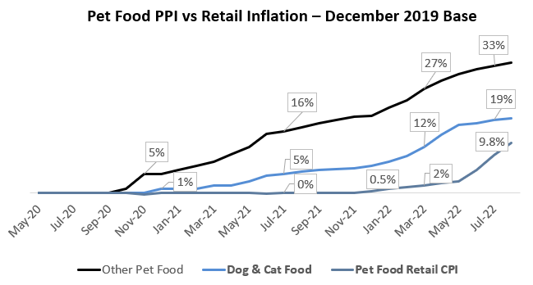
This is a rly important graph, should be included in here or another slide somewhere
Input Cost Pressures may Depress Margins
Although TargetCo and other market leaders have historically passed along raw material increases, these actions may not be sustainable in a high inflation and economically uncertain environment.
With severe Petflation rampant in the industry during COVID, costs skyrocketed in 2019, outpacing retail prices for the industry and smaller stores…
Overall pet food production rose 19.3%,
Particularly, wet dog and cat production costs for instance have surged 38.8% and 25.4% respectively.
…this was driven by global supply chain issues for processed meat, aluminum cans, labor, and fuel.
Margin Squeeze
Mitigant: Although wet or premium food may be traded down, TargetCo has already diversified its product offerings by expanding into the dry pet food space.
This segment has seen substantial ramp up and scale in recent years, with volume and revenue CAGR of 9% and 11% over the past 6 years.
Moreover, TargetCo has brought nearly production domestically, avoiding future tariff cost pressure. They also hedge their risk in an economic downturn with…
Private labels often outperforming national brands in recessions, and
Consumer behavior prioritizing healthier pet food, insulating the wet pet food segment, as many companies are still able to pass costs.
The gap between input costs and retail prices for some producers may eventually impact TargetCo’s bottom-line profitability – especially for the more expensive wet pet food.
Recent tariff penalties on aluminum may also raise costs for the cans of wet pet food.
Sources: Reciprocal Meat Conference, Harris Williams
Tracking Pet Food Pricing: The PPI (Mfg) vs CPI (Retail), John Gibbons
Notes:
foafd

Slide 22
Revenue Tailwinds from “Petflation” Easing
1) Price increases have carried revenue as volume growth slowed from 1.1% to -0.8% in 2022 and 2023, despite COVID and remote work spurring pet adoption.
2) Pet Food is beginning to demonstrate signs of disinflation. Retailers and manufacturers may be restricted from continuing price hikes.
Mitigant: As a market leader and emerging player in private label wet and dry respectively, TargetCo has built a strong reputation, while having a moat created from its production capabilities.
Pet food has remained a steady, acyclical business compared to the rest of CPG, even through economic downturns – owners will prioritize their pets, relative to other categories.
Fear of incoming inflation and instability emerge, as US Consumer Inflation Expectations index rose by 0.5% between February and March 2025.
Source: Trading Economics, Harris Williams, Bureau of Economic Analysis, Circana, CoBank, US Bureau of Labor Statistics

Slide 23




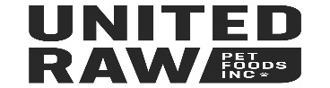

Limited Add-on Opportunities to expand into Dry Market
TargetCo’s minimal add-on history suggests a Buy & Build play in a consolidated industry is restricted, especially considering its recent entry into new markets.
Recent Pet Food Acquisitions
February 2023
~$2 billion valuation for a Canadian-based, US, and global manufacturer of premium and natural pet food categories.
December 2024
$1.5 billion valuation for a Missouri-based producer of natural pet food, bolstering premium cat and treat offerings.
6 Investments under Dane Creek Capital ownership
Rivalry for potential M&A targets exacerbated by weak dry pet market position
With Walmart helping launch the dry pet food as recently as 2018, TargetCo is not the private label market leader in this sector. Incumbents Diamond Pet Company and Alphia combine for over 50% of the market already.
For instance, Alphia carries 1,300 unique kibble SKUs, selling nearly 200 million pounds of dry dog and cat food in 2024. This spans 6 plants, with the 487,000 Ogden, Utah facility producing dry product.
Mitigant: Pet deal activity is subduing post-COVID. More importantly, Veterinary Services is driving pet M&A, with 44% of 2nd Half 2023 deals, while pet food & treats comprise of ~13%. Beyond TargetCo’s leading position in wet pet food, opportunities to acquire the remaining 35% of the outsourced dry market, from the local and regional players, will remain limited to the current players who already possess the capacity to keep expanding manufacturing.
Source: Pet Food Processing, Alphia SEC Filings, The Deal Hound, PitchBook, SDR Ventures, Capital IQ, Capstone Partners, R.L. Hulett, Mars Petcare
Notes:
PE funds successfully executed the buy and build strategy

Slide 24


Retail Giants Fuel Emerging Competition
However, despite private label providing a discount relative to national or legacy brands, some retailers are not shy from supporting new manufacturers that may potentially deteriorate TargetCo’s market position…
The capital required for retailers to backward integrate and build production facilities themselves cannot be easily surpassed, considering a lack of in-house manufacturing, and relying heavily on superior distribution and supply chains.
However, despite private label already providing a discount relative to legacy brands, some retailers are not shy from supporting new manufacturers that may potentially deteriorate TargetCo’s market position…
PetSmart signed its first exclusive partnership with Nom Nom in April 2019 to expand its nutritious, direct-to-consumer fresh pet food offerings.
Founded in 2014, Nom Nom is a niche pet-health brand that sells and manufactures dog food and treats. It was eventually acquired by Mars Inc. in 2022.
Southeast Pet teamed up with Petcurean in December 2024 to provide greater access to premium, healthy pet food in the southeast US.
Petcurean is a 1999, Canadian established and focused pet food formulator, working with a network of 3rd party manufacturers to generate ~$20M USD in revenue.
Mitigant: 1) New greenfields represent a large upfront investment that take several years to scale and generate positive return on invested capital – TargetCo’s latest expansions into the dry pet food and treats required growth CAPEX of ~$9M for multiple years. 2) The potential, high reputational and direct costs associated with less experienced suppliers may risk product recalls, with damages amounting to tens of millions. 3) These partnerships are not in sectors TargetCo directly compete in, alongside the participants not being pure-play manufacturers.
Source: ModernRetail, PitchBook, PetBusiness, PetFoodIndustry
Notes:
PE funds successfully executed the buy and build strategy

Slide 25

Operating Model

Slide 26
Organic Base versus Downside Case with Acquisitions
Base Case Key Drivers
Base case
Downside case
EBITDA
$96M
$59M
EBITDA Margin
12%
10%
SG&A Margin
4%
5%
Strong organic growth through continued premiumization and humanization trends drive volume and pet food spending.
Solid profit margins as price increases follow input pressures, alongside continued industry-leading position and efficiency.
Slight SG&A leverage as volume grows, with TargetCo’s limited sales and marketing needs.
Acquisitions
1 (in 2027)
0
Exit Multiple w/o fees
8.2x
8.0x
Downside Case Key Drivers
TEV at exit
$784
$469
Reflects a scenario where a product recall occurs in 2025, with a significant loss in customers, mirroring the 2011 recall. Pricing power slightly falls subsequentially.
No acquisitions were modeled in, unlike the base case, given TargetCo’s lack of add-on history and competition for targets.
Lower exit multiple because of the firm’s inherent risk from numerous recalls.
IRR
23.10%
3.51%
MOIC
2.8x
1.2x

Slide 27
Base Case: Volume Forecast
In Millions of Cases | 2025 | 2026 | 2027 | 2028 | 2029
Wet Private Label | 28.97 | 29.41 | 29.91 | 30.45 | 31.06
% change | 1.38% | 1.53% | 1.68% | 1.83% | 1.98%
Wet Contract | 14.01 | 14.15 | 14.32 | 14.52 | 14.75
% change | 0.79% | 0.99% | 1.19% | 1.39% | 1.59%
Dry Private Label | 37.42 | 39.79 | 41.72 | 43.12 | 43.91
% change | 7.84% | 6.34% | 4.84% | 3.34% | 1.84%
Treats Private Label | 5.28 | 6.24 | 7.20 | 8.08 | 8.84
% change | 21.3% | 18.3% | 15.3% | 12.3% | 9.3%
Total Volume | 85.7 | 89.6 | 93.1 | 96.2 | 98.5
Volume Trends
Total volume is forecasted to grow at +15% from $85.7M to $98.5M between 2025 to 2029.
Wet segments saw modest growth as premium pet food becomes more popular.
Dry Private Label remains the largest category in terms of units sold, despite a long-term gradual slowdown.
Treats saw the fastest, growth as the most recent business segment entry.
Wet food
Dry food
Treats

Slide 28
Base Case: Revenue Forecast per Segment
Revenue and Volume Comparison
TargetCo is projected to reach $797M in revenue by 2029, supported by its four segments.
While wet food will account for 46% of total volumes, it will drive 72% of revenue, reflecting premium positioning and higher price points. In contrast, the dry food segment will represent 45% of volumes but contribute only 25% of revenue due to its lower pricing.
Lastly, treats, introduced in 2022, will make up 9% of volumes by 2029, as it continues to progress in its growth phase, expanding partnerships with new retailers.
 | 2025 | 2026 | 2027 | 2028 | 2029
Wet Private Label | $321 | $338 | $358 | $379 | $402
% growth | 5.43% | 5.59% | 5.74% | 5.90% | 6.05%
Wet Contract | $142 | $148 | $156 | $165 | $174
% growth | 4.52% | 4.83% | 5.13% | 5.44% | 5.75%
Dry Private Label | $155 | $168 | $180 | $191 | $200
% growth | 9.91% | 8.60% | 7.27% | 5.95% | 4.61%
Treats Private Label | $11 | $14 | $16 | $19 | $21
% growth | 24.94% | 21.9% | 18.76% | 15.67% | 12.6%
Revenue | $628 | $669 | $710 | $753 | $797

Slide 29
Base Case: Price Forecast per Segment and Acquisition
Price Increases by Segment
Prices are projected to increase steadily across all segments in line with inflation.
Wet food (private label) and treats experience steady annual price increases of 4% and 3%, respectively.
Meanwhile, wet food (contract) and dry food saw increasing price growth, with prices rising to $11.8 and $4.5 per unit by the end of the forecast period.
Price per Unit | 2025 | 2026 | 2027 | 2028 | 2029
Wet - Private Label | 11.1 | 11.5 | 12.0 | 12.4 | 12.9
% change | 4.0% | 4.0% | 4.0% | 4.0% | 4.0%
Wet - Contract | 10.1 | 10.5 | 10.9 | 11.3 | 11.8
% change | 3.7% | 3.8% | 3.9% | 4.0% | 4.1%
Dry - Private Label | 4.1 | 4.2 | 4.3 | 4.4 | 4.5
% change | 1.9% | 2.1% | 2.3% | 2.5% | 2.7%
Treats - Private Label | 2.1 | 2.2 | 2.3 | 2.3 | 2.4
% change | 3.0% | 3.0% | 3.0% | 3.0% | 3.0%
Acquisitions
Multiple
6x
Purchase price
$3M
We projected one acquisition because we expect tough competition from other strategic buyers – especially within the dry pet food sector – alongside TargetCo's limited acquisition history.
The multiple was taken at a discount of the original entry multiple. This is because TargetCo will look to snap up smaller mom-and-pops as part of its expansion.
The low entry EBITDA represents how the pet food manufacturing industry is inherently capital intensive, hindering high margins. Nevertheless, the target has the potential for synergy and efficiency improvements, once it gets added to TargetCo’s portfolio.
EBITDA
0.5M

Slide 30
Downside Case: Operating Projections and Assumptions
Operational Shock Scenario: A Repeat of the 2011 Crisis
A major product recall in 2025, mirroring the 2011 melamine crisis, will severly impact TargetCo’s performance. It will create a sharp drop in volumes, erode pricing power, and result in the loss of key customers. Like in 2011, the crisis disrupts growth plans and eliminates any near-term acquisition opportunities, driving EBITDA down and reducing IRR to ~3.7%.
Consequences for TargetCo
The 2025 recall significantly impacts sales volumes, with an overall decline of 3.37% that year.
The most affected segments are Wet Contract, down 8%, and Wet Private Label, down 3%.
Dry food and treats experience more moderate declines of 2%.
By 2029, volumes are projected to recover to 12.97M cases for Wet Contract, 28.27M for Wet Private Label, 33M for Dry Food, and 4.14M for Treats, resulting in a modest overall volume growth of just 1.2%.
Following the recall, TargetCo faces reputational damage that significantly reduces its ability to raise prices. Across all segments, pricing growth is limited to just 1% annually, compared to 3-4% increases in the base case.
Wet food (private label) remains the most expensive category, reaching $11.18 per unit by 2029.
Treats remain the least expensive, increasing only marginally from $2.10 to $2.19 over the forecast period.

Slide 31
Financial Comparison between Base versus Downside
Revenue Forecast
In the downside scenario, revenue growth slows significantly, increasing by only $25M over five years, compared to a $169M gain in the base case.
Revenue declines during the first two years following the recall, before gradually recovering.
By 2029, growth turns positive but remains modest, reaching only a 2.7% increase.
EBITDA Forecast
In the downside scenario, EBITDA drops by 5% in 2025 but quickly stabilizes.
Over the following five years, it remains relatively flat, increasing by only $3M, in contrast to the base case, where EBITDA grows by 10% annually to reach $95M by 2029.
This underlines the long-term impact of the recall and a more limited upside without pricing power or acquisitions.

Slide 32
LBO Mini-Model

Slide 33
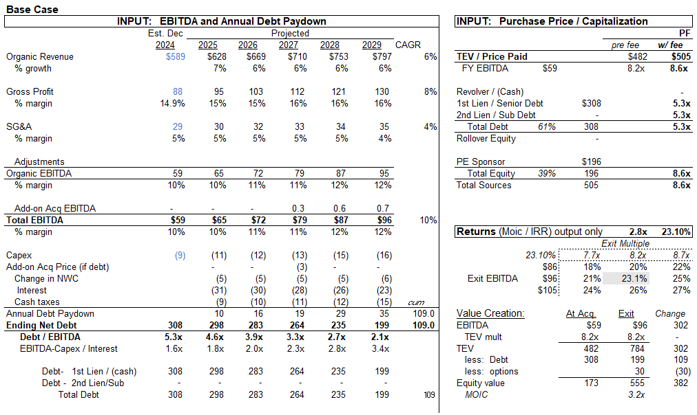

Base Case LBO
The exit multiple was set equivalent to the entry multiple. We believe there many be less levers to pull by 2029, given the firm’s maturity and aggressive expansion into the dry and treat industry beginning to cap out.

Slide 34
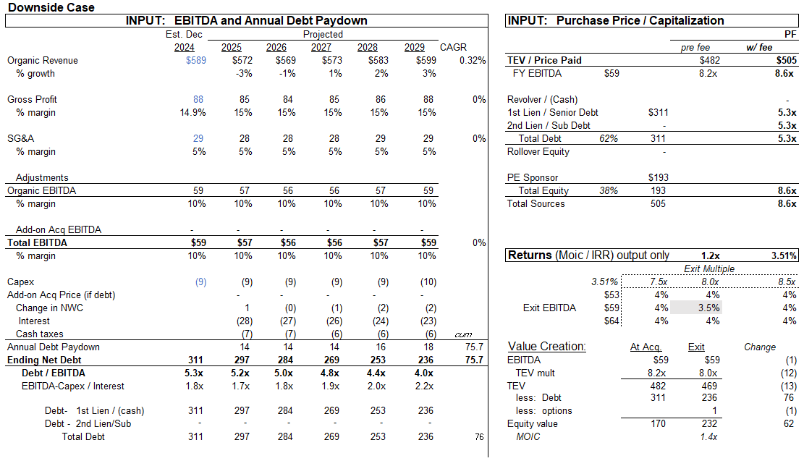
Downside Case LBO
The exit multiple was set lower to the entry multiple. Alongside having less levers to pull after a 5-year holding period, as discussed in the base case, two large product recalls and reputational damages may dissuade future investors.

Slide 35
References
https://www.petfoodprocessing.net/articles/16526-pet-nutrition-demand-fuels-more-than-2-billion-in-facility-investments
https://seamerco.co/the-complex-process-of-producing-pet-food-inside-the-factory/
https://smartfoodsafe.com/pet-food-manufacturing/
https://ksvdl.org/resources/news/diagnostic_insights/january2021/aflatoxin-pet-food-recall.html
https://www.petfoodprocessing.net/articles/16048-is-inflation-impacting-pet-food-spending
https://www.iastatedigitalpress.com/mmb/article/id/14397/
https://scalescorporation.co.nz/wp-content/uploads/2024/06/Global-Proteins-Presentation.pdf
https://www.petfoodindustry.com/pet-food-market/article/15468345/wet-dry-and-treat-pet-food-usage-a-birdseye-view
https://www.postholdings.com/wp-content/uploads/2025/02/Post-Investor-Presentation-1Q25-FINAL.pdf
https://www.oliverwyman.com/our-expertise/insights/2024/may/5-strategies-for-success-changing-pet-food-market.html
https://www.aaha.org/wp-content/uploads/globalassets/05-pet-health-resources/veterinary-ecommerce_2019_secure.pdf
https://www.capstonepartners.com/wp-content/uploads/2023/08/Capstone-Partners-Pet-MA-Coverage-Report_July-2023.pdf
https://www.cascadiacapital.com/wp-content/uploads/2023/06/Pet-Industry-Overview_Spring-2023.pdf
ttps://plma.com/sites/default/files/files/2024-02/yearend-report2024-final.pdf
https://www.circana.com/post/private-labels-take-a-bite-out-of-europe-s-pet-food-market-giving-retailers-34-share-of-10-8-billi
Is This Private Label Cycle Different
https://www.petfoodindustry.com/pet-food-market/article/15468345/wet-dry-and-treat-pet-food-usage-a-birdseye-view
https://assets.ctfassets.net/xpbu77rkft4z/QizvhbNFPOWpkKAk5wUMk/e445e5986e70d4896c5c039924ae1ee1/Opportunities_and_New_Frontiers_in_Pet_-_Harris_Williams_and_OC_C__January_2023_.pdf
https://www.cbsnews.com/news/inflation-trump-tariffs-economists-forecast-2025/
https://www.fanniemae.com/research-and-insights/forecast/economic-developments-february-2025
https://www.petfoodprocessing.net/articles/18446-slideshow-alphia-shepherds-pet-food-treat-industry-through-growth
https://www.iopp.org/files/PMMI-Pet_Food_Market_Webinar-pmmibranded.pdf
https://www.forbes.com/sites/joanverdon/2019/07/19/profitability-chewy-has-a-plan-for-that/?sh=6ac2b9bd7b3a
https://www.emarketer.com/content/how-pet-industry-addressing-inflation-convenience-health-wellness-5-charts

